Slide 1

Database Design and Programming
SQL 5 Group Functions
Chapter 11

Slide 2
Purpose of Group Functions
Group functions are used to aggregate a number of values into a single value
Group functions can be used to:
calculate sum, average, standard deviation or variance
find the largest or smallest value in a list
count the number of rows returned

Slide 3
Group Functions
Return one result per group of rows processed
Group functions are also known as multiple-row or aggregate functions
All group functions ignore NULL values except COUNT(*)
Use DISTINCT to suppress duplicate values
Oracle 12c: SQL

Slide 4
Commonly Used Group Functions
SUM, AVG, STDDEV, VARIANCE
Numeric values
MAX, MIN,COUNT
Numeric, Char and Date values

Slide 5
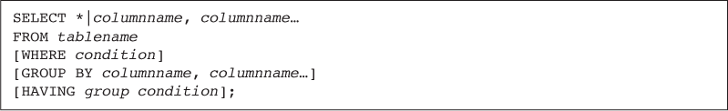
Added Clauses
Oracle 12c: SQL

Slide 6
SUM Function
Calculates total amount stored in a numeric column for a group of rows
What is the total value of order# 1007?
SELECT order#, item#, isbn, quantity, paideach, quantity*paideach
FROM orderitems
WHERE order#=1007;
SUM the column quantity*paideach
Oracle 12c: SQL
Notes:
SELECT order#, item#, isbn, quantity, paideach, quantity*paideach
FROM orderitems
WHERE order#=1007;

Slide 7
Total Value of Order #1007
select sum(quantity*paideach)
from orderitems
where order# = 1007;

Slide 8
AVG Function
Calculates the average of a set of numeric values in a specified column
What is the average $ profit of all computer books?
select avg(retail-cost) "Average Profit"
from books
where category = 'COMPUTER';
Oracle 12c: SQL

Slide 9
COUNT Function
Two purposes
Count non-NULL values
based on a spe
Count total records, including those with NULL values
Oracle 12c: SQL

Slide 10
COUNT Function – Unique Values
Include column name in argument to count number of occurrences
How many different book categories are there?
select count(distinct category) "# of Categories"
from books;
Oracle 12c: SQL

Slide 11
COUNT Function Counting Non Nulls values
How many books have a discount?
select count(discount)
from books;

Slide 12
COUNT Function – NULL Values
Include asterisk in argument to count number of rows
How many orders have not been shipped (no shipdate)?
select count(*)
from orders
where shipdate is null;
Oracle 12c: SQL

Slide 13
MAX Function
Returns largest value
What is the highest profit for a single book?
select max(retail-cost) from books;
Which book has the highest profit ???
Requires a sub-query
select *
from books
where retail-cost =
(select max(retail-cost) from books);
Oracle 12c: SQL

Slide 14
MIN Function
Returns the smallest value
When was the oldest book published?
select min(pubdate) from books;
What was the oldest book??
Requires a multi-row sub-query
select *
from books
where pubdate =
(select min(pubdate) from books);
Oracle 12c: SQL

Slide 15
Datatypes
The COUNT, MIN, and MAX functions can be used on values with character, numeric, and date datatypes
Oracle 12c: SQL
Notes:
What is the alphabetically largest name ?
select max(lastname)
from customers;

Slide 16
Creating Groups
GROUP BY clause
Used to group data
Must be used for any individual column in the SELECT clause with a group function
Cannot reference column aliases
Oracle 12c: SQL

Slide 17
GROUP BY Example
Show the average profitability and the # of books in each category.
Create groups of data based on the category and then apply the AVG function to each group
select category, avg(retail-cost) "Profit",
count(*) "# of Books"
from books
group by category;
Oracle 12c: SQL

Slide 18
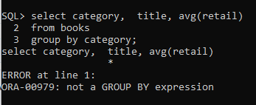
Common Error
A common error is missing a GROUP BY clause for nonaggregated columns in the SELECT clause
Oracle 12c: SQL
Notes:
-- correction:
select category, avg(retail)
from books
group by category;

Slide 19
Restricting Groups
When included in the same SELECT statement, the clauses are evaluated in the order of:
WHERE
GROUP BY
HAVING
Oracle 12c: SQL

Slide 20
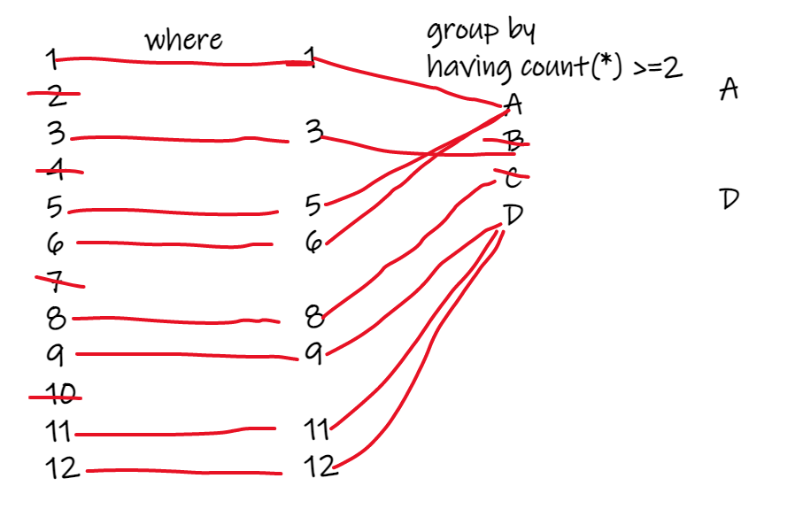
Affect of WHERE and HAVING
Notes:
WHERE restricts the rows that go into forming the groups.
HAVING restricts the groups that are reported.

Slide 21
Restricting Groups Reported
HAVING clause limits which groups are included in the output.
It’s like a WHERE clause for the groups.
Show the average profitability of each book category. ONLY include categories whose average profitability is greater than $15.
select category, avg(retail-cost) "Profit"
from books
group by category
having avg(retail-cost) > 15;
Oracle 12c: SQL

Slide 22
Restricting Aggregated Output (continued)
Show the average profitability of each book category, only include categories that have 2 or more books published after Jan 1, 2004.
Which phrase restricts the rows included in the groups?
Which phrase restricts the groups included in the result?
Oracle 12c: SQL

Slide 23
Solution
select category, title, retail-cost, pubdate
from books
where pubdate > '01-JAN-04'
order by 1;
select category, count(*) "# of Books"
from books
where pubdate > '01-JAN-04'
group by category
having count(*) >= 2;

Slide 24
Nesting Functions
What is the highest average profitability based on book category. Here is the original query:
SELECT category, avg(retail-cost) "Profit"
FROM books
GROUP BY category;
Solution:
select max(avg(retail-cost)) "Max Profit"
from books
group by category;
Oracle 12c: SQL

Slide 25
Statistical Group Functions
Based on normal distribution
Includes:
STDDEV
VARIANCE
Oracle 12c: SQL

Slide 26
STDDEV Function
Show the average retail price and the standard deviation in the retail price for all book categories.
select category, avg(retail), stddev(retail), count(*)
from books
group by category;
Oracle 12c: SQL

Slide 27
Summary
The AVG, SUM, STDDEV, and VARIANCE functions are used only with numeric fields
The COUNT, MAX, and MIN functions can be applied to any datatype
The AVG, SUM, MAX, MIN, STDDEV, and VARIANCE functions all ignore NULL values
By default, the AVG, SUM, MAX, MIN, COUNT, STDDEV, and VARIANCE functions include duplicate values
©2016. Cengage Learning. All rights reserved.

Slide 28
Summary (continued)
The GROUP BY clause is used to divide table data into groups
If a SELECT clause contains both an individual field name and a group function, the field name must also be included in a GROUP BY clause
The HAVING clause is used to restrict groups in a group function
Group functions can be nested to a depth of only two. The inner function is always performed first, using the specified grouping. The results of the inner function are used as input for the outer function.
©2016. Cengage Learning. All rights reserved.

Slide 29
Summary (continued)
The STDDEV and VARIANCE functions are used to perform statistical analyses on a set of data
©2016. Cengage Learning. All rights reserved.

